Slide 1

Ashutosh Joshi

Slide 2
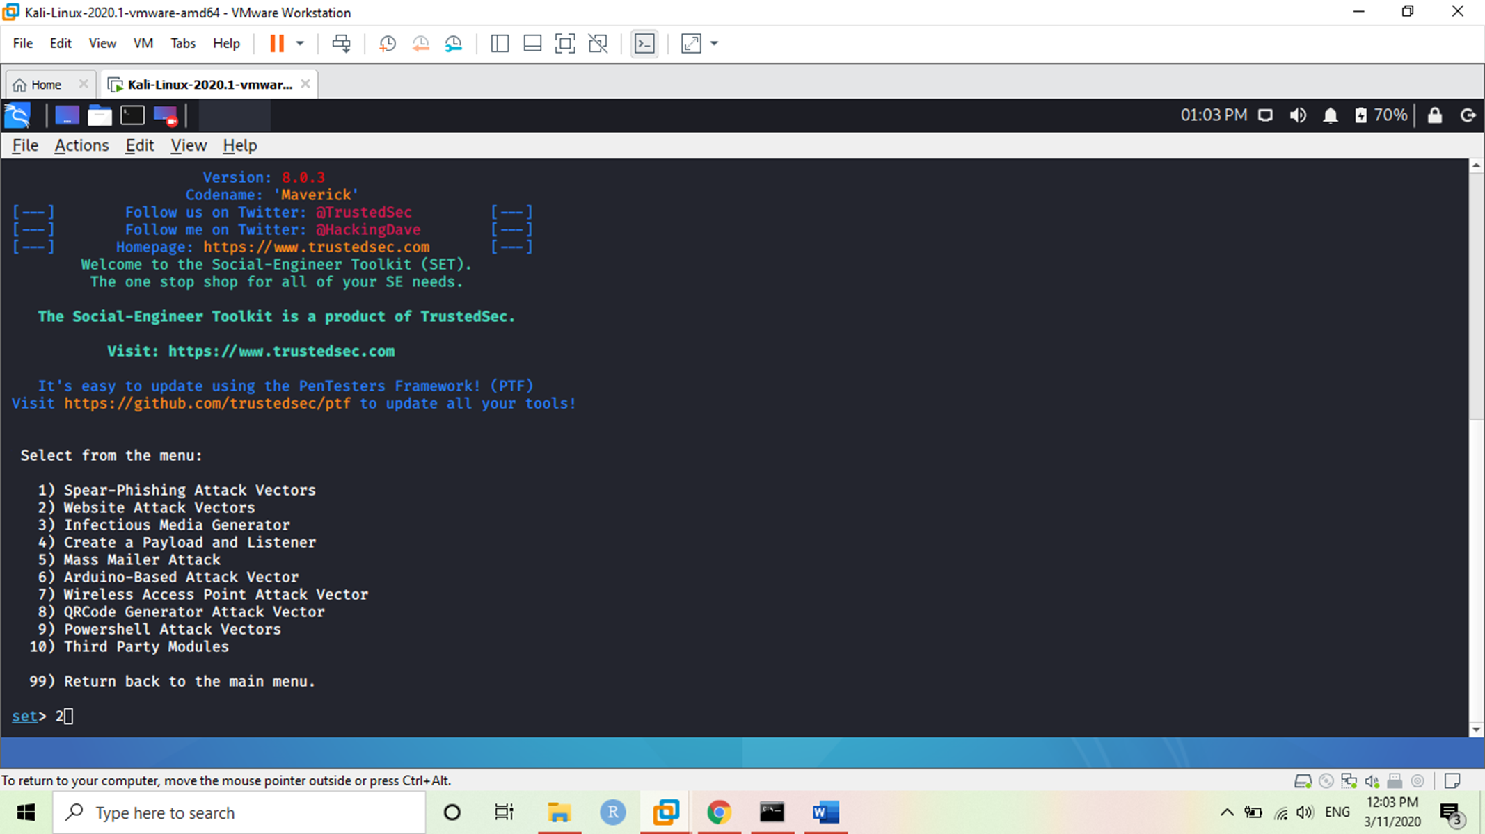
Social engineering toolkit Kali: It is used for penetration testing framework designed for social engineering.
Selecting required options for our attack which is selecting option 2
Which is website Attack

Slide 3
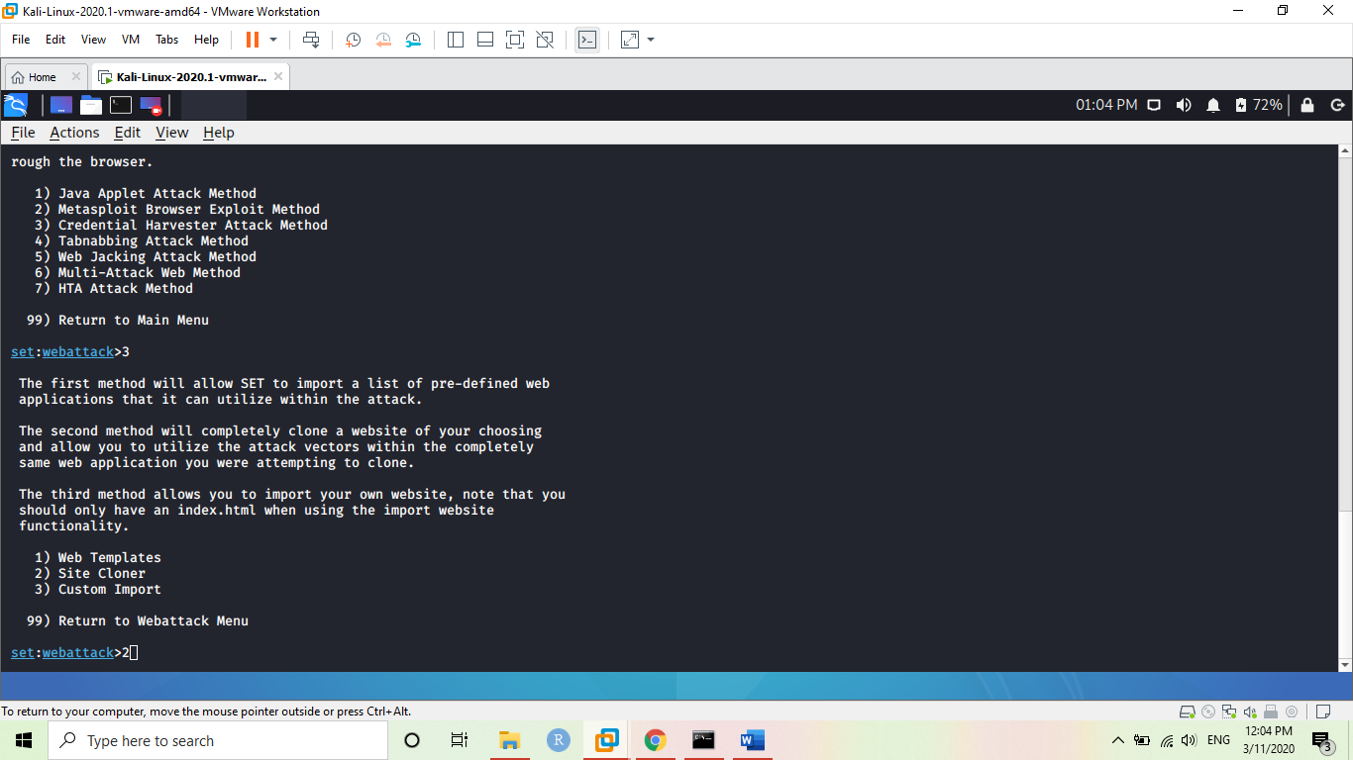
Selecting option 3 which is Credential Harvest attack
Now Selecting option
2 which we will be using to get some details of users.

Slide 4
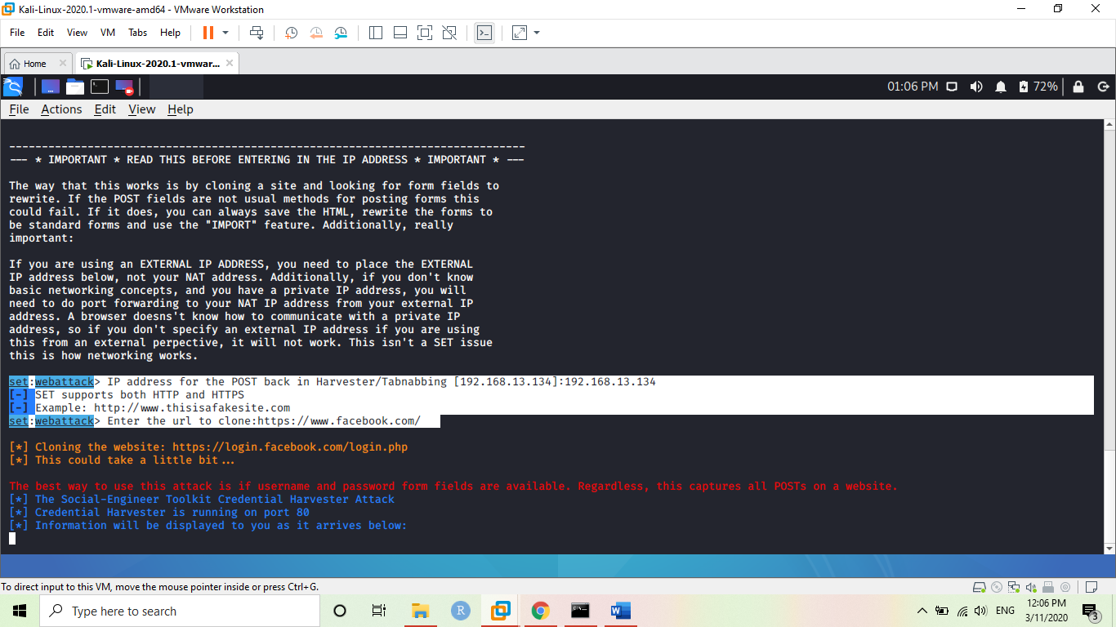
Now we fill the required fields for our attacks Adding the IP address and cloning address. Now adding the IP address of the target which is 192.168.13.134 Adding url to clone : https://www.facebook.com This will clone on provide IP and address in out Stool kit.

Slide 5
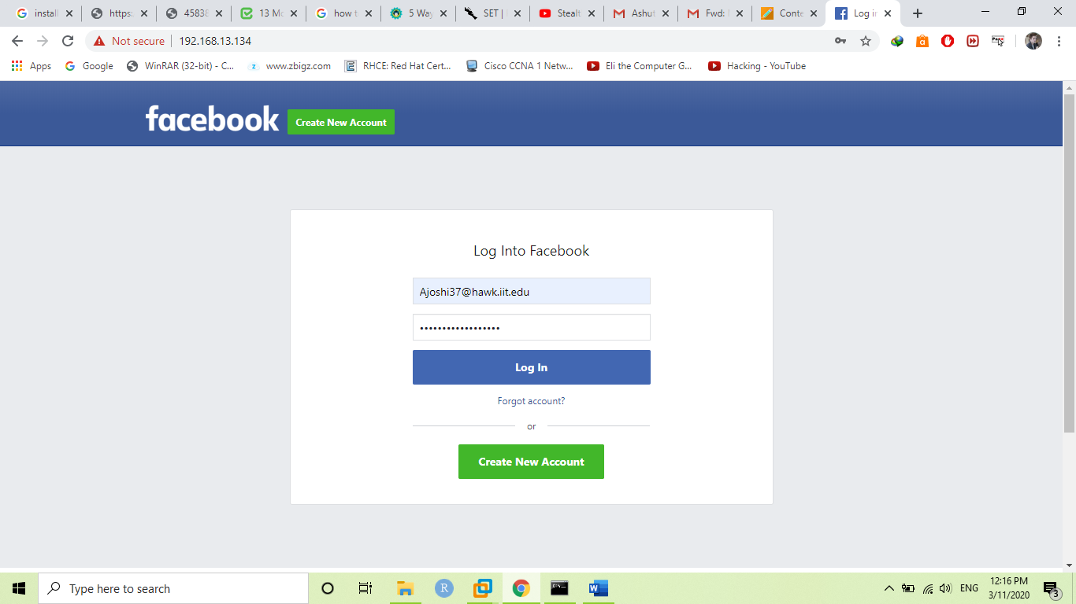
Now waiting for the target to open the Facebook.
As the target open https://Facebook.com it will open as the same Facebook page and when he enter his details to this cloned site we will be able to see his login details.

Slide 6
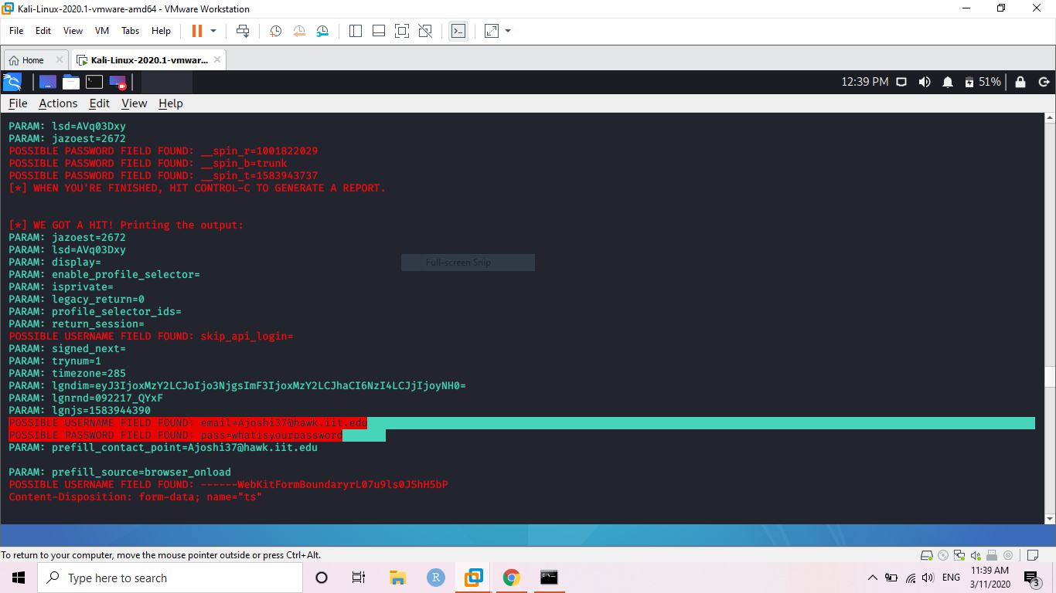
If we look in the highlighted portion we can the username and the password of our target which is
Email ajoshi37@hawk.ii.edu
Password
Whatisyourpassword

Slide 7
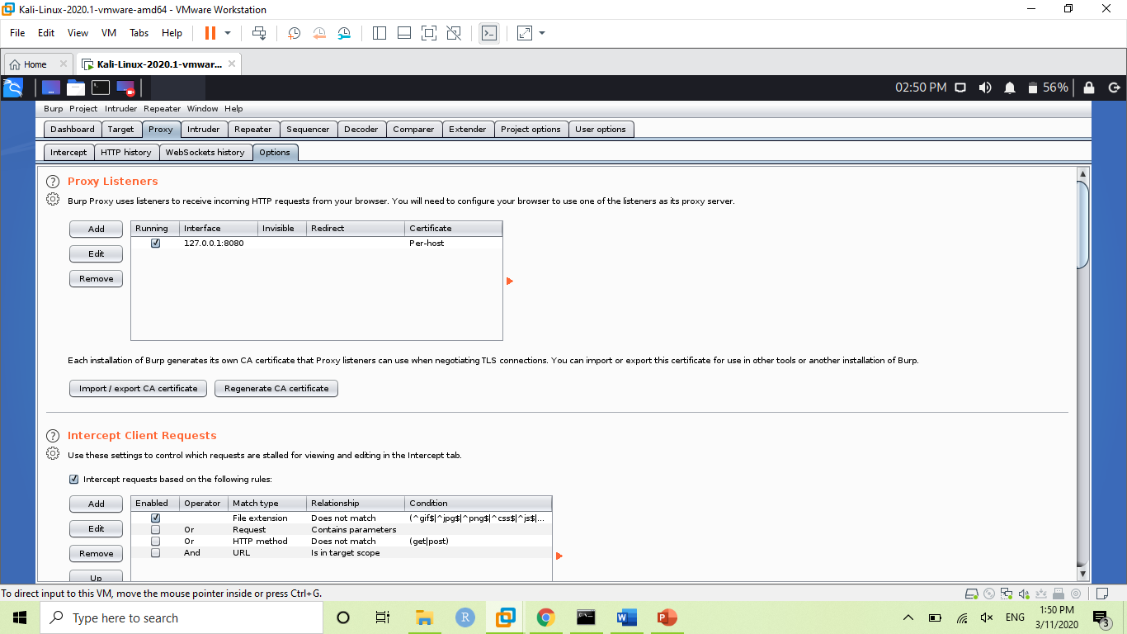
Pentest- 2 Burpsuite
Open burpsuit than go to
Proxy < Options
And select proxy.

Slide 8
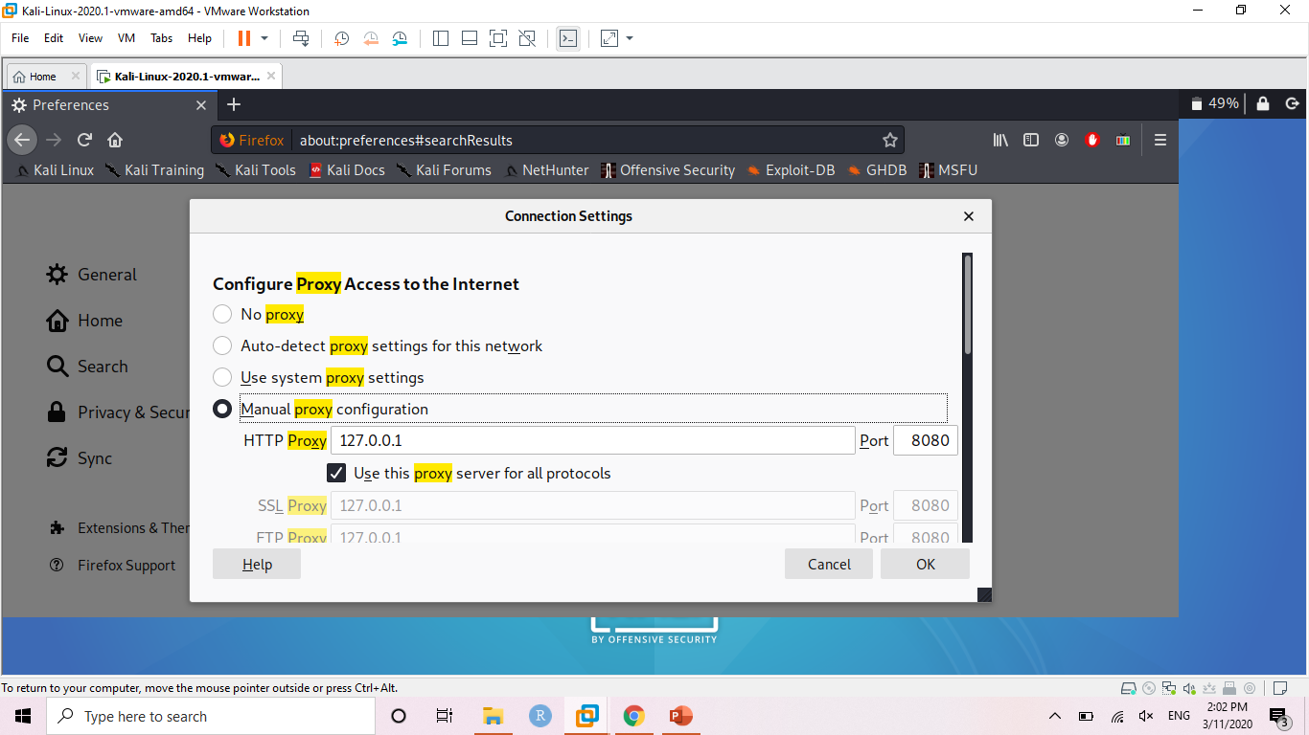
Now setting the same ip address and port numbers in our browser of kali.
Open Web browser for kali Linux. Than go to
Setting < Preferences < proxy setting. Than change the proxy to 127.0.0.1 same as Burpsuite.

Slide 9
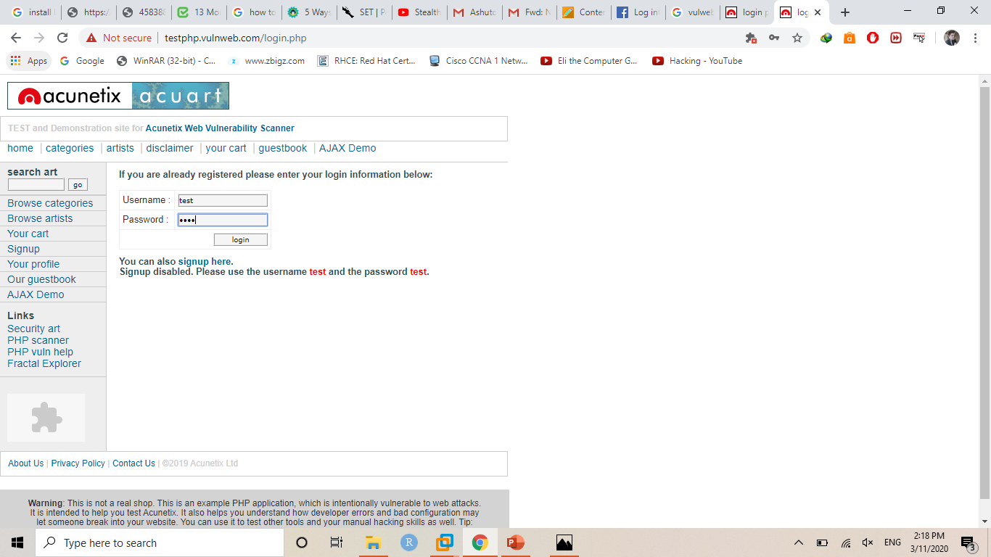
Now open the site for which we want to get details. And add
Now provide some random username and password for vulweb site.
For example I provided test and test.

Slide 10
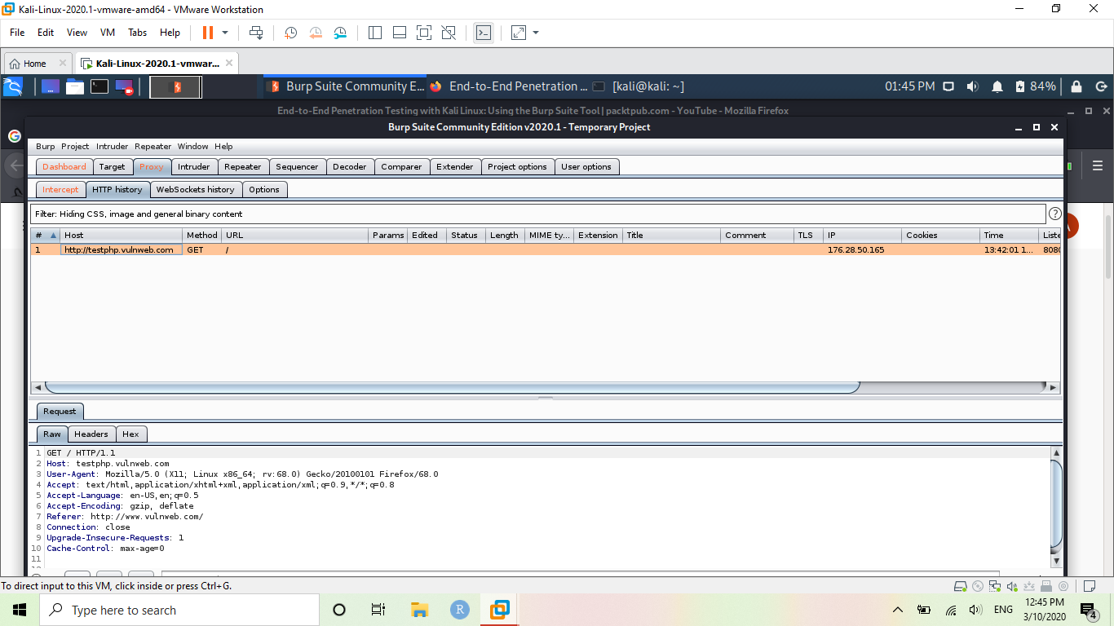
Now we open Burpsuite and we can see our target and host are intercepting to each other.
Now we are getting request from the browser and we intercepted it used Burpsuite.

Slide 11
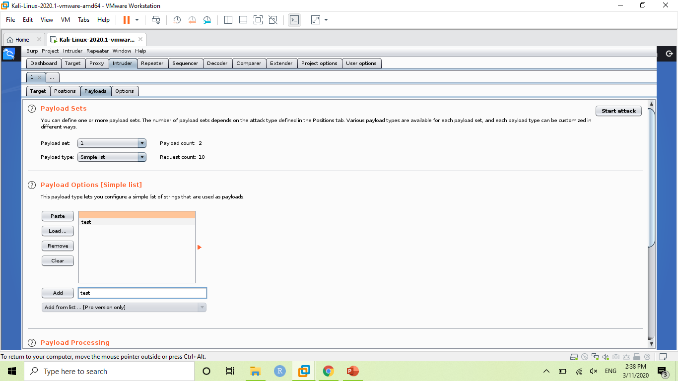
In this we will try to guess the password or we can load a dictionary to get the details of username and password by brute force attack.
We go to the
Intruder < 1 < payloads
And select payload options to add guess for username and password. Like here I added test and test so burp can work with that or we can upload our required dictionary to it.

Slide 12
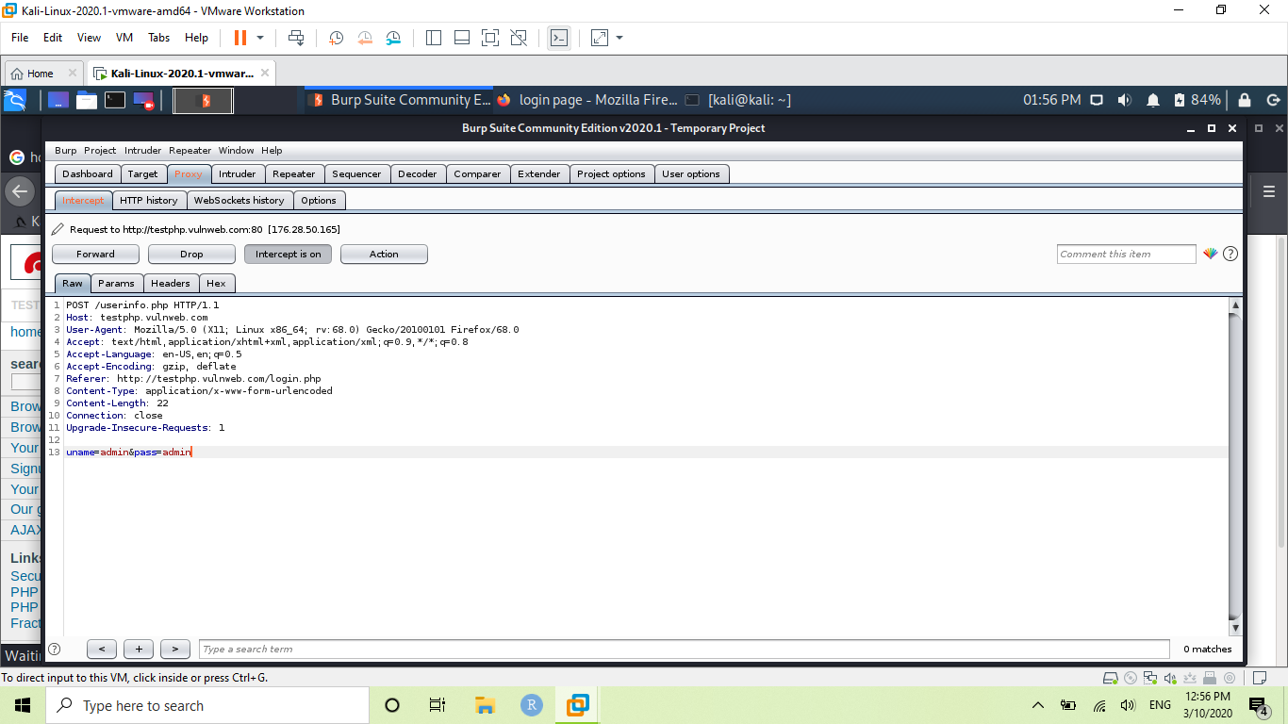
So, our brute force attack was successful. It showed use the correct details of user in raw tab.
If we go to the Raw tab we will able to see the real username and password of a user.

Slide 13
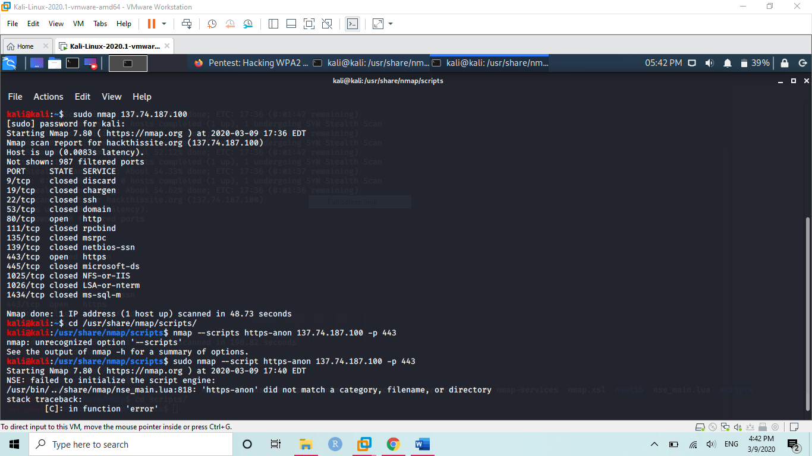
PEN: 3 Nmap port scanning.
We are scanning the Hackthissite and searching for how many ports are open and what details we can get from nmap scans.

Slide 14
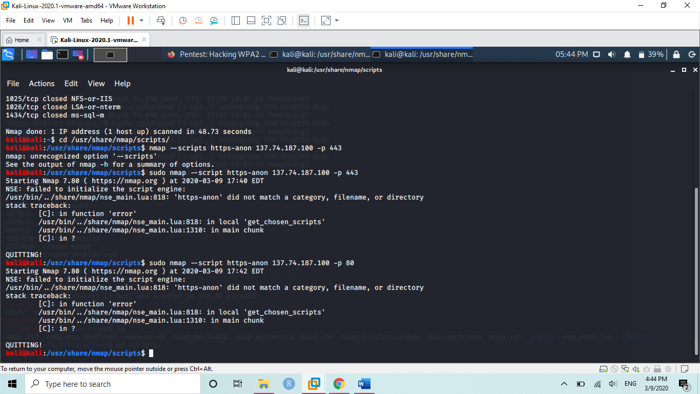
Now we at our Nmap directory to get into the acquired ports from the Nmap scans.
Passing the address and required port number we can easily access the required port.

